Slide 1
Section Introduction
Anuranjan Srivastava(codersaty)

Slide 2
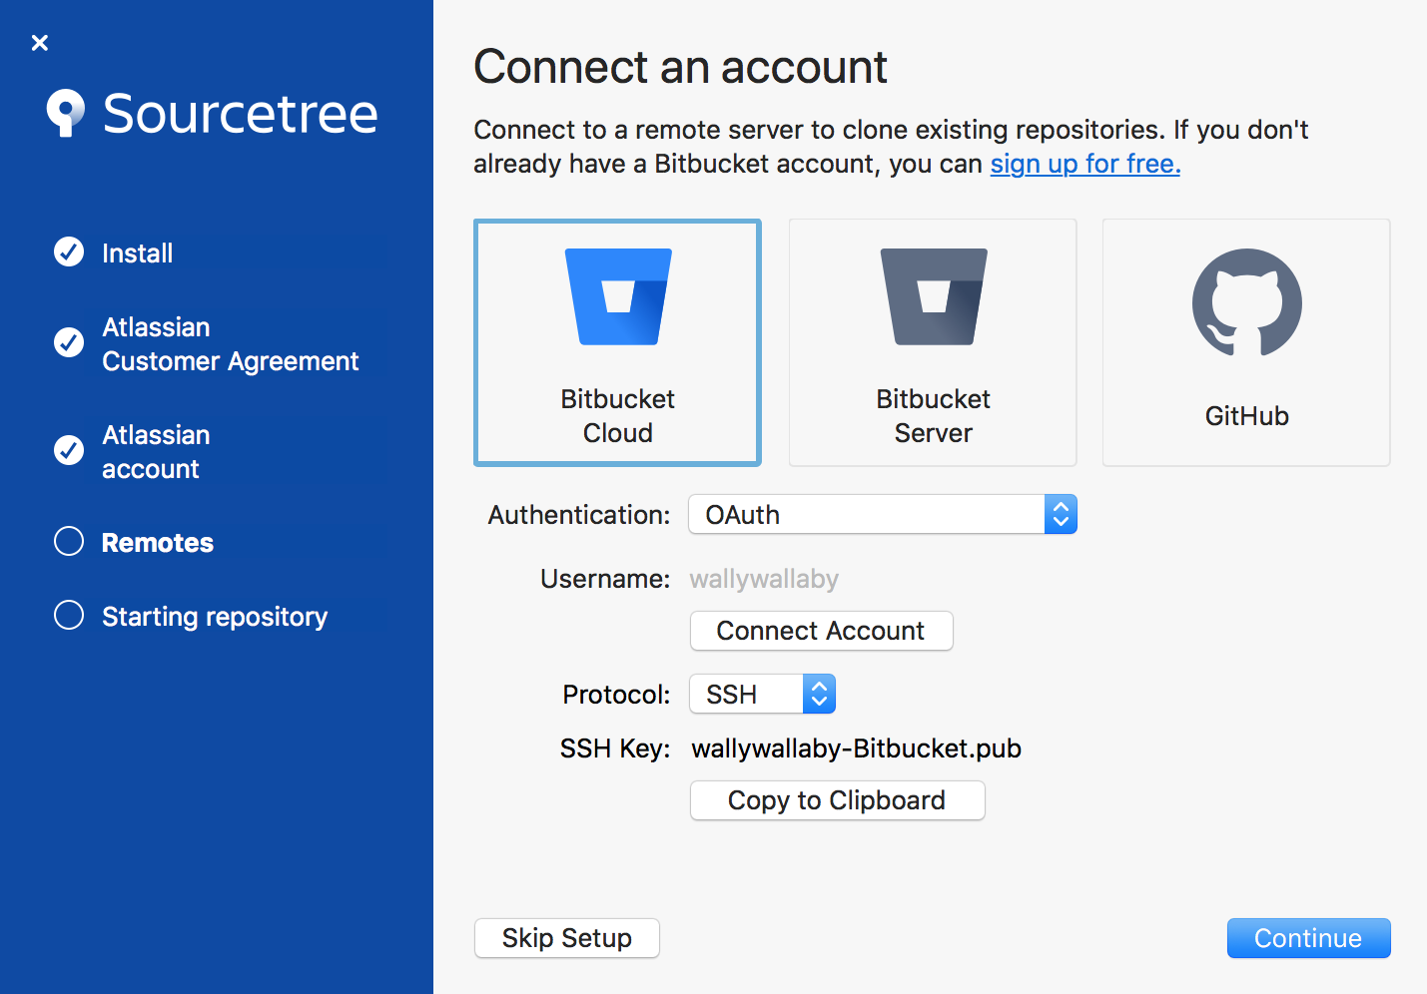
Overview
In this section, we will look at using all of the skills we learned in a Git GUI.
We will also look at the theory behind a GUI, and why you might want to use it.
This could give you an alternate way to use Git if you are not comfortable with the terminal.

Slide 3

Basic Features
We will first look at SourceTree features for local repositories (init, add, commit)
We will also look at some of the differences between a terminal and a GUI in terms of using Git.

Slide 4
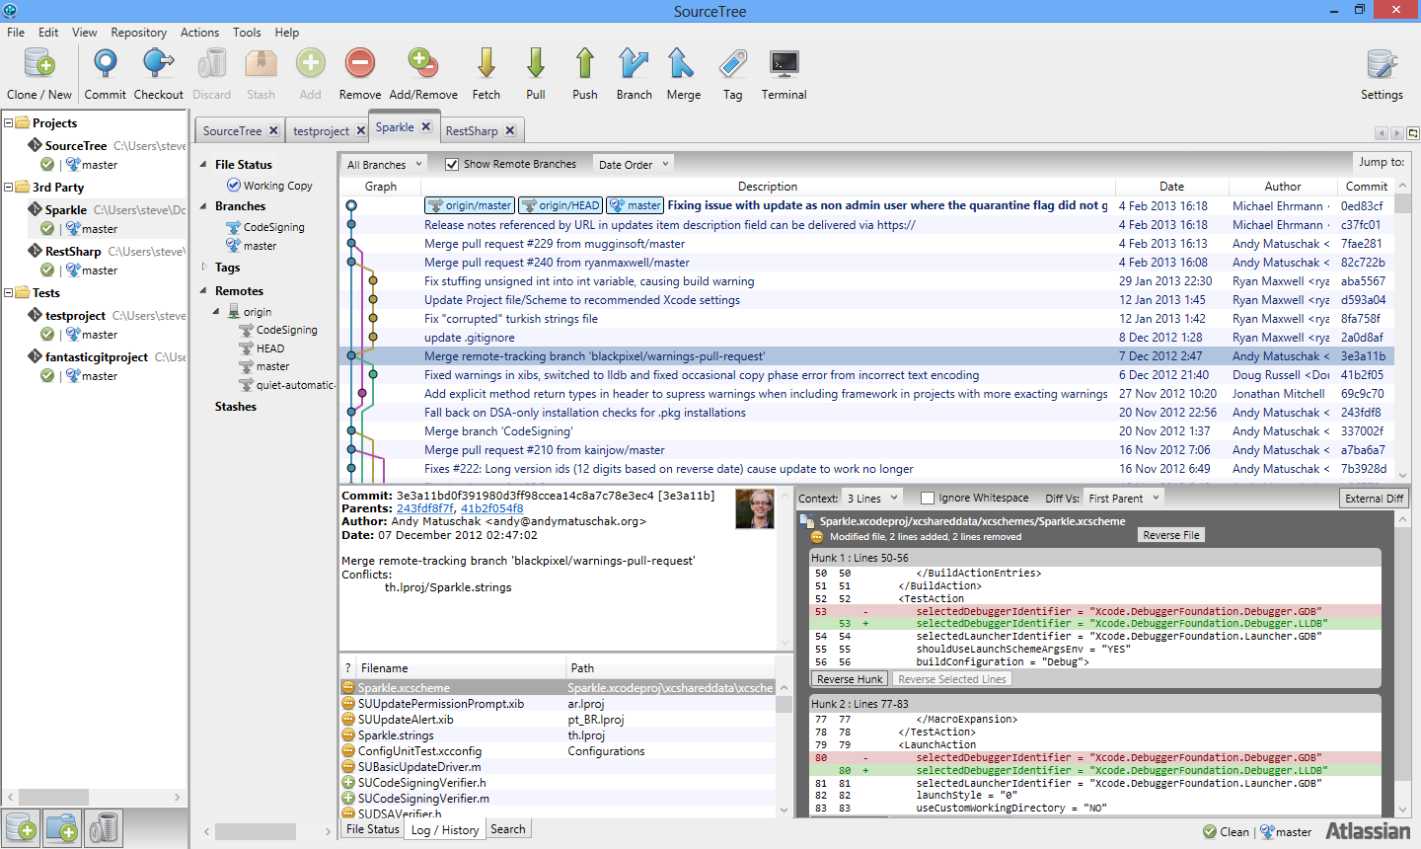
Network Features
We will then start to look at using remote features, such as push and pull.
We will use these features to bring Git & GitHub together using SourceTree.

Slide 5
Lets Get Started!
Anuranjan Srivastava(codersaty)

